Slide 1
Informed Search
Please wear your masks
Optional Course Content Recitation on Tonight from 8-9pm
Notes:
Read AIMA 3.1-3.6.
Some materials will not
be covered in lecture, but
will be on the exam

Slide 2
Review: Search problem definition
States: a set S
An initial state s_{i}∈S
Actions: a set A
∀ s Actions(s) = the set of actions that can be executed in s, that are applicable in s.
Transition Model: ∀ s∀ a∈Actions(s) Result(s, a) → s_{r}
s_{r} is called a successor of s
{s_{i} }∪ Successors(s_{i} )* = state space
Path cost (Performance Measure): Must be additive
e.g. sum of distances, number of actions executed, …
c(x,a,y) is the step cost, assumed ≥ 0
(where action a goes from state x to state y)
Goal test: Goal(s)
Can be implicit, e.g. checkmate(s)
s is a goal state if Goal(s) is true

Slide 3
Review: Useful Concepts
State space: the set of all states reachable from the initial state by any sequence of actions
When several operators can apply to each state, this gets large very quickly
Might be a proper subset of the set of configurations
Path: a sequence of actions leading from one state s_{j} to another state s_{k}
Frontier: those states that are available for expanding (for applying legal actions to)
Solution: a path from the initial state s_{i} to a state s_{g} that satisfies the goal test
Notes:
.

Slide 4
Onderon
71
Polis Massa
Coruscant
87
151
Iridonia
75
Alderaan
140
Starkiller Base
92
Endor
99
118
Vandor-1
80
Ryloth
Tatooine
Lotho Minor
142
111
Naboo
211
97
70
98
Mandalore
85
Hoth
146
101
Bespin
75
138
86
Kessel
Dagobah
120
90
Fondor
Zygerria
Geonosis

Slide 5
Onderon
71
Coruscant
Polis Massa
87
151
Iridonia
75
Alderaan
140
Starkiller Base
Endor
92
99
118
80
Vandor-1
Ryloth
Tatooine
111
142
Naboo
211
Lotho Minor
97
98
70
Hoth
Mandalore
101
85
146
Bespin
138
86
75
Kessel
120
Dagobah
90
Geonosis
Zygerria
Fondor

Slide 6
Onderon
Coruscant
Polis Massa
Iridonia
Alderaan
Starkiller Base
Endor
Vandor-1
Ryloth
Tatooine
Naboo
Lotho Minor
Hoth
Mandalore
Bespin
Kessel
Dagobah
Geonosis
Zygerria
Fondor

Slide 7
Onderon
Coruscant
Polis Massa
Iridonia
Starkiller Base
Alderaan
Endor
Vandor-1
Tatooine
Ryloth
Naboo
Lotho Minor
Hoth
Mandalore
Bespin
Kessel
Dagobah
Geonosis
Fondor
Zygerria

Slide 8
Search Tree
Root node = start state
Alderaan
Expanded nodes
Starkiller Base
Tatooine
Coruscant
Alderaan
Onderon
Endor
Ryloth
Alderaan
Lotho Minor
Alderaan
Starkiller Base
Frontier
Choose leaf node from frontier for expansion according to to the search strategy
Determines the search process

Slide 9
Review: Search Strategies
Strategy = order of tree expansion
Implemented by different queue structures (LIFO, FIFO, priority)
Dimensions for evaluation
Completeness- always find the solution?
Optimality - finds a least cost solution (lowest path cost) first?
Time complexity - # of nodes generated (worst case)
Space complexity - # of nodes simultaneously in memory (worst case)
Time/space complexity variables
b, maximum branching factor of search tree
d, depth of the shallowest goal node
m, maximum length of any path in the state space (potentially ∞)
CIS 521 | 7
Notes:
.

Slide 10
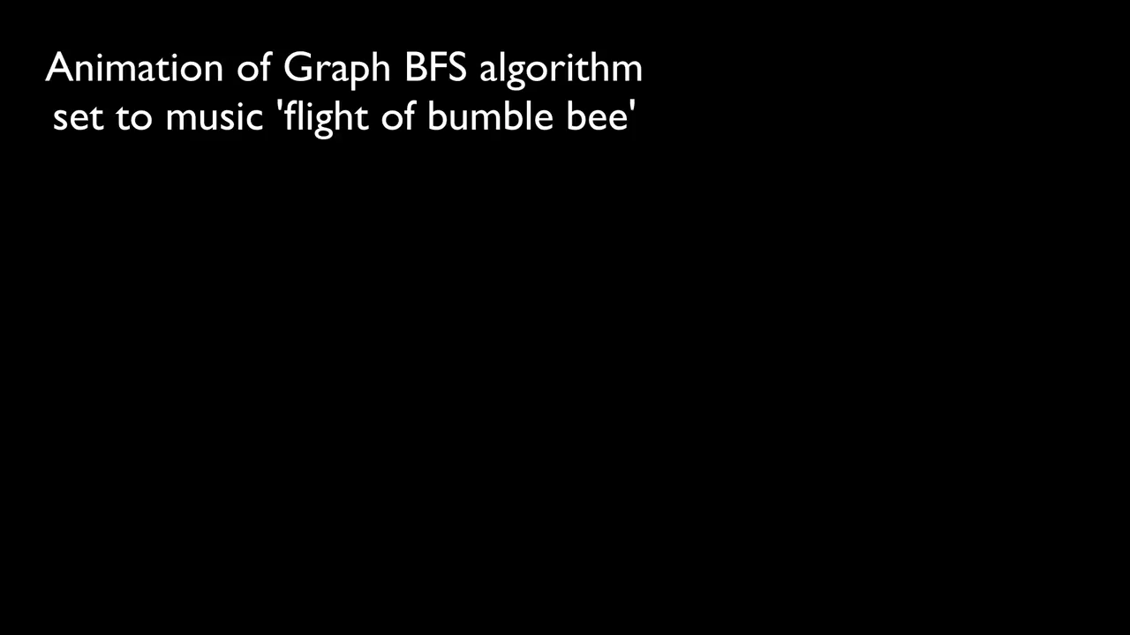

Breadth first search
https://youtu.be/x-VTfcmrLEQ
Notes:
.

Slide 11
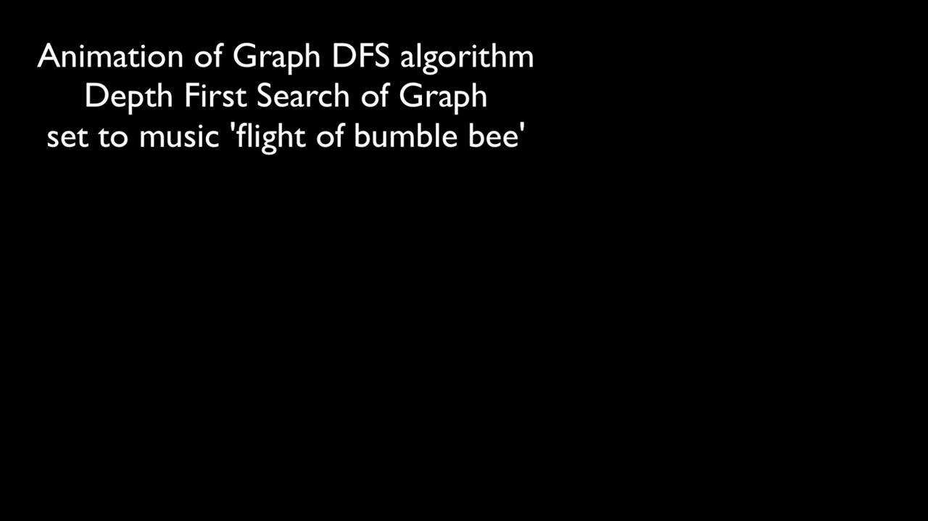
https://youtu.be/NUgMa5coCoE
Notes:
.

Slide 12
“Uniform Cost” Search
“In computer science, uniform-cost search (UCS) is a tree search algorithm used for traversing or searching a weighted tree, tree structure, or graph.” - Wikipedia
Notes:
.

Slide 13
Motivation: Map Navigation Problems
All our search methods so far assume step-cost = 1
This is only true for some problems
Notes:
.

Slide 14
g(N): the path cost function
Our assumption so far: All moves equal in cost
Cost = # of nodes in path-1
g(N) = depth(N) in the search tree
More general: Assigning a (potentially) unique cost to each step
N₀, N₁, N₂, N₃ = nodes visited on path p from N₀ to N₃
C(i,j): Cost of going from N_{i} to N_{j}
If N₀ the root of the search tree, g(N3)=C(0,1)+C(1,2)+C(2,3)
Notes:
.

Slide 15
Uniform-cost search (UCS)
Extension of BF-search:
Expand node with lowest path cost
Implementation:
frontier = priority queue ordered by g(n)
Subtle but significant difference from BFS:
Tests if a node is a goal state when it is selected for expansion, not when it is added to the frontier.
Updates a node on the frontier if a better path to the same state is found.
So always enqueues a node before checking whether it is a goal.
WHY???
Notes:
.

Slide 16


Shape of Search
Breadth First Search explores equally in all directions. Its frontier is implemented as a FIFO queue. This results in smooth contours or “plys”.
Uniform Cost Search lets us prioritize which paths to explore. Instead of exploring all possible paths equally, it favors lower cost paths. Its frontier is a priority queue. This results in “cost contours”.
Notes:
.

Slide 17
Onderon
Uniform Cost Search
71
Coruscant
Polis Massa
87
151
g(n)<300
Iridonia
75
Alderaan
140
Starkiller Base
Endor
92
99
g(n)<200
118
80
Vandor-1
Ryloth
Tatooine
111
142
Naboo
211
g(n)<100
Lotho Minor
97
98
70
Hoth
Mandalore
101
85
146
Bespin
138
WRONG
WAY!!!!
86
75
Kessel
120
Dagobah
90
Geonosis
Zygerria
Fondor

Slide 18
Onderon
Uniform Cost Search
71
Coruscant
Polis Massa
87
151
g(n)<300
Iridonia
75
Alderaan
140
Starkiller Base
Endor
92
99
g(n)<200
118
80
Vandor-1
Ryloth
Tatooine
111
142
Naboo
211
g(n)<100
Lotho Minor
97
98
70
Hoth
Mandalore
101
85
146
Bespin
138
WRONG
WAY!!!!
86
75
Kessel
120
Dagobah
90
Geonosis
Zygerria
Fondor

Slide 19
Onderon
71
Coruscant
Polis Massa
87
151
Iridonia
75
Alderaan
140
Starkiller Base
Endor
92
99
118
80
Vandor-1
Ryloth
Tatooine
111
142
Naboo
211
Lotho Minor
97
98
70
Hoth
Mandalore
101
85
146
Bespin
138
86
75
Kessel
120
Dagobah
90
Geonosis
Zygerria
Fondor

Slide 20
Onderon
Onderon
Uniform Cost Search
71
Coruscant
Polis Massa
87
Iridonia
151
Iridonia
151
g(n)<300
75
Alderaan
Alderaan
Starkiller Base
140
Starkiller Base
140
Endor
Endor
92
92
99
99
g(n)<200
118
Vandor-1
80
Vandor-1
80
Ryloth
Ryloth
Ryloth
Tatooine
142
111
Naboo
g(n)<100
142
Naboo
Naboo
211
211
97
Lotho Minor
97
98
98
70
Hoth
Hoth
85
Hoth
101
85
Mandalore
146
101
146
Bespin
Bespin
86
138
WRONG
WAY!!!!
86
138
Kessel
75
Kessel
120
120
Dagobah
Dagobah
90
90
Geonosis
Geonosis
Zygerria
Zygerria
Zygerria
Fondor
Fondor

Slide 21
A Better Idea…
Node expansion based on an estimate which includes distance to the goal
General approach of informed search:
Best-first search: node selected for expansion based on an evaluation function f(n)
f(n) includes estimate of distance to goal (new idea!)
Implementation: Sort frontier queue by this new f(n).
Special cases: greedy search, and A* search
Notes:
.

Slide 22
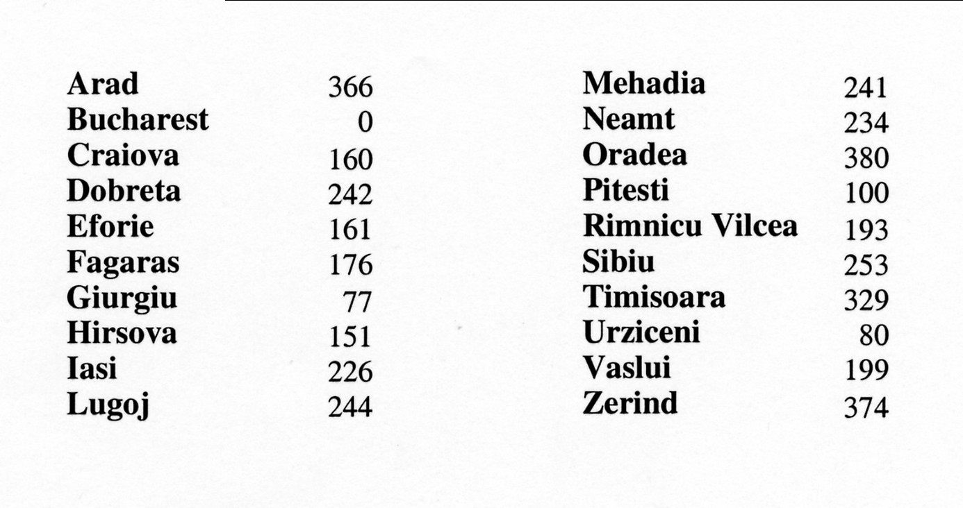
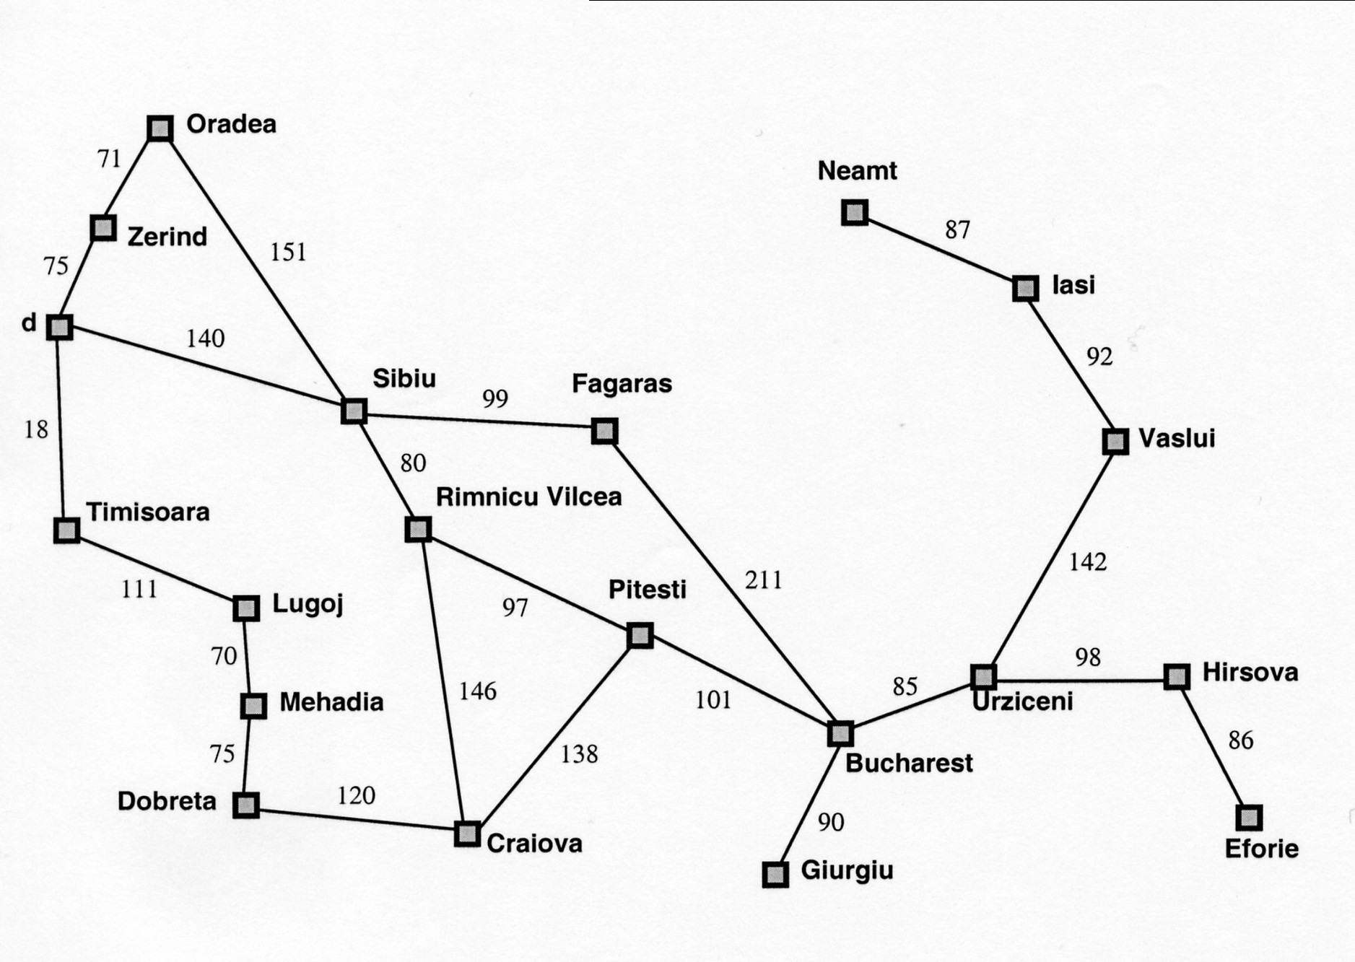
Simple, useful estimate heuristic: straight-line distances
Arad
118
Notes:
.

Slide 23
Onderon
Simple, useful estimate heuristic: straight-line distances
Alderaan | 366 |  | Mandalore | 241
Kessel | 0 |  | Polis Massa | 234
Zygerria | 160 |  | Onderon | 380
Dagobah | 242 |  | Naboo | 100
Fondor | 161 |  | Ryloth | 193
Endor | 176 |  | Starkiller Base | 253
Geonosis | 77 |  | Tatooine | 329
Hoth | 151 |  | Bespin | 80
Iridonia | 226 |  | Vandor-1 | 199
Lotho Minor | 244 |  | Coruscant | 374
71
Polis Massa
Coruscant
87
151
Iridonia
75
Alderaan
140
Starkiller Base
92
Endor
99
118
Vandor-1
80
Ryloth
Tatooine
Lotho Minor
142
111
Naboo
211
97
70
98
Mandalore
85
Hoth
146
101
Bespin
75
138
86
Kessel
Dagobah
120
90
Fondor
Zygerria
Geonosis

Slide 24

Heuristic (estimate) functions
[dictionary]“A rule of thumb, simplification, or educated guess that reduces or limits the search for solutions in domains that are difficult and poorly understood.”
Heuristic knowledge is useful, but not necessarily correct.
Heuristic algorithms use heuristic knowledge to solve a problem.
A heuristic function h(n) takes a state n and returns an estimate of the distance from n to the goal.
Heureka! ---Archimedes
Notes:
(graphic: http://hyperbolegames.com/2014/10/20/eureka-moments/)

Slide 25
Greedy Best-First Search
First attempt at integrating heuristic knowledge
Notes:
.

Slide 26
Review: Best-first search
Basic idea:
select node for expansion with minimal evaluation function f(n)
where f(n) is some function that includes estimate heuristic h(n) of the remaining distance to goal
Implement using priority queue
Exactly UCS with f(n) replacing g(n)
Notes:
.

Slide 27
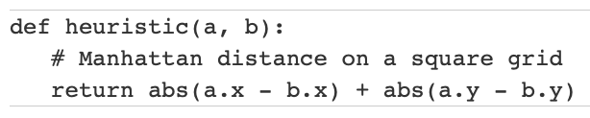
Greedy best-first search: f(n) = h(n)
Expands the node that is estimated to be closest to goal
Completely ignores g(n): the cost to get to n
In our Romanian map, h(n) = h_{SLD}(n) = straight-line distance from n to Bucharest
In a grid, the heuristic distance can be calculated using the “Manhattan distance”:
Notes:
.

Slide 28
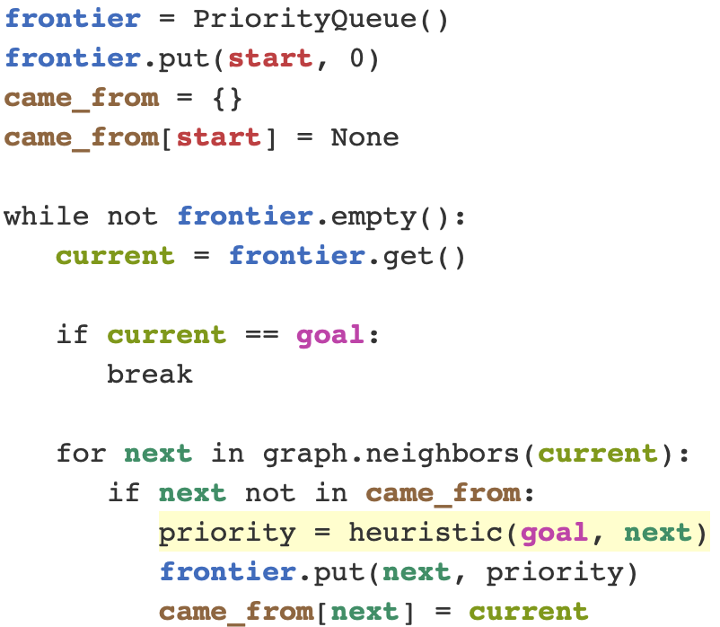
Greedy best-first search
Code from Amit Patel of Red Blob Games
This is not the solution to the HW assignment.
Notes:
.

Slide 29
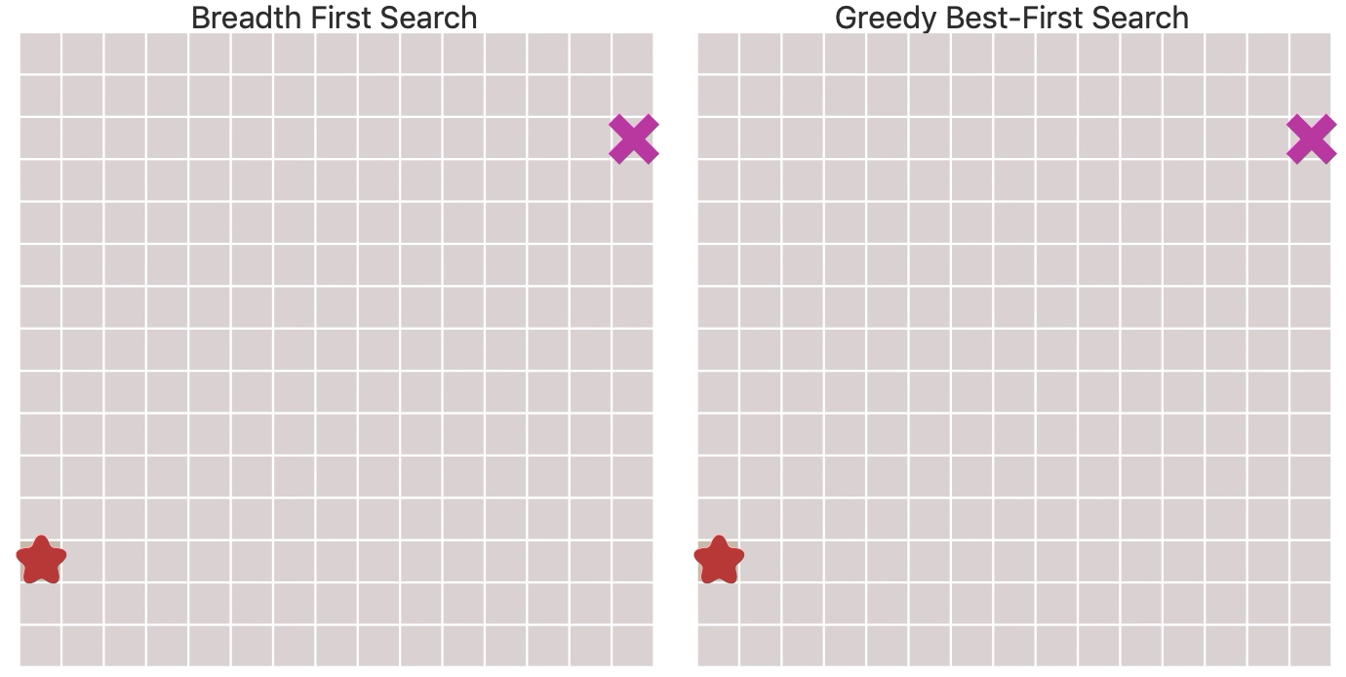
BFS v. Greedy Best-First Search
https://www.redblobgames.com/pathfinding/a-star/introduction.html
Notes:
.

Slide 30
Greedy best-first search example
Alderaan
Initial State: Alderaan Goal State: Kessel
Starkiller Base
Tatooine
Coruscant
Alderaan
Onderon
Endor
Ryloth
Alderaan
Lotho Minor
Alderaan
Starkiller Base
Frontier queue:
Planet | SLD |  | Planet | SLD
Alderaan | 366 |  | Lotho Minor | 244
Bespin | 80 |  | Mandalore | 241
Coruscant | 374 |  | Naboo | 100
Dagobah | 242 |  | Onderon | 380
Endor | 176 |  | Polis Massa | 234
Fondor | 161 |  | Ryloth | 193
Geonosis | 77 |  | Starkiller Base | 253
Hoth | 151 |  | Tatooine | 329
Iridonia | 226 |  | Vandor-1 | 199
Kessel | 0 |  | Zygerria | 160
Alderon 266

Slide 31
Greedy best-first search example
Alderaan
Initial State: Alderaan Goal State: Kessel
Frontier queue:
Planet | SLD |  | Planet | SLD
Alderaan | 366 |  | Lotho Minor | 244
Bespin | 80 |  | Mandalore | 241
Coruscant | 374 |  | Naboo | 100
Dagobah | 242 |  | Onderon | 380
Endor | 176 |  | Polis Massa | 234
Fondor | 161 |  | Ryloth | 193
Geonosis | 77 |  | Starkiller Base | 253
Hoth | 151 |  | Tatooine | 329
Iridonia | 226 |  | Vandor-1 | 199
Kessel | 0 |  | Zygerria | 160
Alderon 266

Slide 32
Greedy best-first search example
Alderaan
Initial State: Alderaan Goal State: Kessel
Starkiller Base
Tatooine
Coruscant
Frontier queue:
Planet | SLD |  | Planet | SLD
Alderaan | 366 |  | Lotho Minor | 244
Bespin | 80 |  | Mandalore | 241
Coruscant | 374 |  | Naboo | 100
Dagobah | 242 |  | Onderon | 380
Endor | 176 |  | Polis Massa | 234
Fondor | 161 |  | Ryloth | 193
Geonosis | 77 |  | Starkiller Base | 253
Hoth | 151 |  | Tatooine | 329
Iridonia | 226 |  | Vandor-1 | 199
Kessel | 0 |  | Zygerria | 160
Starkiller Base 253
Tatooine 329
Coruscant 374

Slide 33
Greedy best-first search example
Alderaan
Initial State: Alderaan Goal State: Kessel
Starkiller Base
Tatooine
Coruscant
Alderaan
Onderon
Endor
Ryloth
Frontier queue:
Planet | SLD |  | Planet | SLD
Alderaan | 366 |  | Lotho Minor | 244
Bespin | 80 |  | Mandalore | 241
Coruscant | 374 |  | Naboo | 100
Dagobah | 242 |  | Onderon | 380
Endor | 176 |  | Polis Massa | 234
Fondor | 161 |  | Ryloth | 193
Geonosis | 77 |  | Starkiller Base | 253
Hoth | 151 |  | Tatooine | 329
Iridonia | 226 |  | Vandor-1 | 199
Kessel | 0 |  | Zygerria | 160
Tatooine 329
Coruscant 374
Alderaan 366
Onderon 380
Endor 176
Ryloth 193

Slide 34
Greedy best-first search example
Alderaan
Initial State: Alderaan Goal State: Kessel
Starkiller Base
Tatooine
Coruscant
Alderaan
Onderon
Endor
Ryloth
Frontier queue:
Planet | SLD |  | Planet | SLD
Alderaan | 366 |  | Lotho Minor | 244
Bespin | 80 |  | Mandalore | 241
Coruscant | 374 |  | Naboo | 100
Dagobah | 242 |  | Onderon | 380
Endor | 176 |  | Polis Massa | 234
Fondor | 161 |  | Ryloth | 193
Geonosis | 77 |  | Starkiller Base | 253
Hoth | 151 |  | Tatooine | 329
Iridonia | 226 |  | Vandor-1 | 199
Kessel | 0 |  | Zygerria | 160
Endor 176
Ryloth 193
Tatooine 329
Alderaan 366
Coruscant 374
Onderon 380

Slide 35
Greedy best-first search example
Alderaan
Initial State: Alderaan Goal State: Kessel
Starkiller Base
Tatooine
Coruscant
Alderaan
Onderon
Endor
Ryloth
Frontier queue:
Planet | SLD |  | Planet | SLD
Alderaan | 366 |  | Lotho Minor | 244
Bespin | 80 |  | Mandalore | 241
Coruscant | 374 |  | Naboo | 100
Dagobah | 242 |  | Onderon | 380
Endor | 176 |  | Polis Massa | 234
Fondor | 161 |  | Ryloth | 193
Geonosis | 77 |  | Starkiller Base | 253
Hoth | 151 |  | Tatooine | 329
Iridonia | 226 |  | Vandor-1 | 199
Kessel | 0 |  | Zygerria | 160
Starkiller Base
Kessel
Ryloth 193
Tatooine 329
Alderaan 366
Coruscant 374
Onderon 380
Starkiller Base 253
Kessel 0

Slide 36
Greedy best-first search example
Alderaan
Initial State: Alderaan Goal State: Kessel
Starkiller Base
Tatooine
Coruscant
Alderaan
Onderon
Endor
Ryloth
Frontier queue:
Planet | SLD |  | Planet | SLD
Alderaan | 366 |  | Lotho Minor | 244
Bespin | 80 |  | Mandalore | 241
Coruscant | 374 |  | Naboo | 100
Dagobah | 242 |  | Onderon | 380
Endor | 176 |  | Polis Massa | 234
Fondor | 161 |  | Ryloth | 193
Geonosis | 77 |  | Starkiller Base | 253
Hoth | 151 |  | Tatooine | 329
Iridonia | 226 |  | Vandor-1 | 199
Kessel | 0 |  | Zygerria | 160
Starkiller Base
Kessel
Kessel 0
Ryloth 193
Starkiller Base 253
Tatooine 329
Alderaan 366
Coruscant 374
Onderon 380

Slide 37
Greedy best-first search example
Alderaan
Initial State: Alderaan Goal State: Kessel
Starkiller Base
Tatooine
Coruscant
Alderaan
Onderon
Endor
Ryloth
Frontier queue:
Planet | SLD |  | Planet | SLD
Alderaan | 366 |  | Lotho Minor | 244
Bespin | 80 |  | Mandalore | 241
Coruscant | 374 |  | Naboo | 100
Dagobah | 242 |  | Onderon | 380
Endor | 176 |  | Polis Massa | 234
Fondor | 161 |  | Ryloth | 193
Geonosis | 77 |  | Starkiller Base | 253
Hoth | 151 |  | Tatooine | 329
Iridonia | 226 |  | Vandor-1 | 199
Kessel | 0 |  | Zygerria | 160
Starkiller Base
Kessel
Ryloth 193
Starkiller Base 253
Goal reached !!
Tatooine 329
Alderaan 366
Coruscant 374
Onderon 380

Slide 38
Properties of greedy best-first search
Optimal?
No!
Found: Alderaan → Starkiller Base→ Endor→ Kessel (450km)
Shorter: Alderaan→ Starkiller Base → Ryloth→ Naboo→ Kessel (418km)
Notes:
.

Slide 39
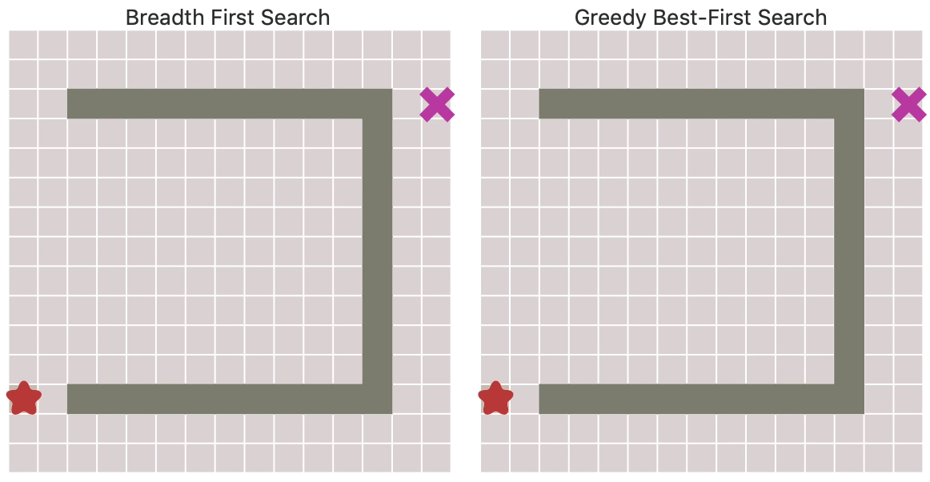
BFS v. Greedy Best-First Search
https://www.redblobgames.com/pathfinding/a-star/introduction.html
Notes:
.

Slide 40
Properties of greedy best-first search
Planet | SLD |  | Planet | SLD
Alderaan | 366 |  | Lotho Minor | 244
Bespin | 80 |  | Mandalore | 241
Coruscant | 374 |  | Naboo | 100
Dagobah | 242 |  | Onderon | 380
Endor | 176 |  | Polis Massa | 234
Fondor | 161 |  | Ryloth | 193
Geonosis | 77 |  | Starkiller Base | 253
Hoth | 151 |  | Tatooine | 329
Iridonia | 226 |  | Vandor-1 | 199
Kessel | 0 |  | Zygerria | 160
Complete?
No – can get stuck in loops,
e.g., Iridonia → Polis Massa→ Iridonia → Polis Massa →…
Notes:
.

Slide 41
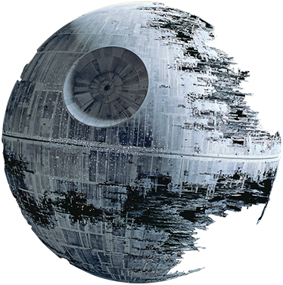
A* search
AIMA 3.5
Notes:
.

Slide 42
A* search
Best-known form of best-first search.
Key Idea: avoid expanding paths that are already expensive, but expand most promising first.
Simple idea: f(n)=g(n) + h(n)
g(n) the actual cost (so far) to reach the node
h(n) estimated cost to get from the node to the goal
f(n) estimated total cost of path through n to goal
Implementation: Frontier queue as priority queue by increasing f(n) (as expected…)
Notes:
.

Slide 43
Key concept: Admissible heuristics
A heuristic h(n) is admissible if it never overestimates the cost to reach the goal; i.e. it is optimistic
Formally:∀n, n a node:
h(n) ≤ h*(n) where h*(n) is the true cost from n
h(n) ≥ 0 so h(G)=0 for any goal G.
Example: h_{SLD}(n) never overestimates the actual road distance
Theorem: If h(n) is admissible, A* using Tree Search is optimal
Notes:
.

Slide 44
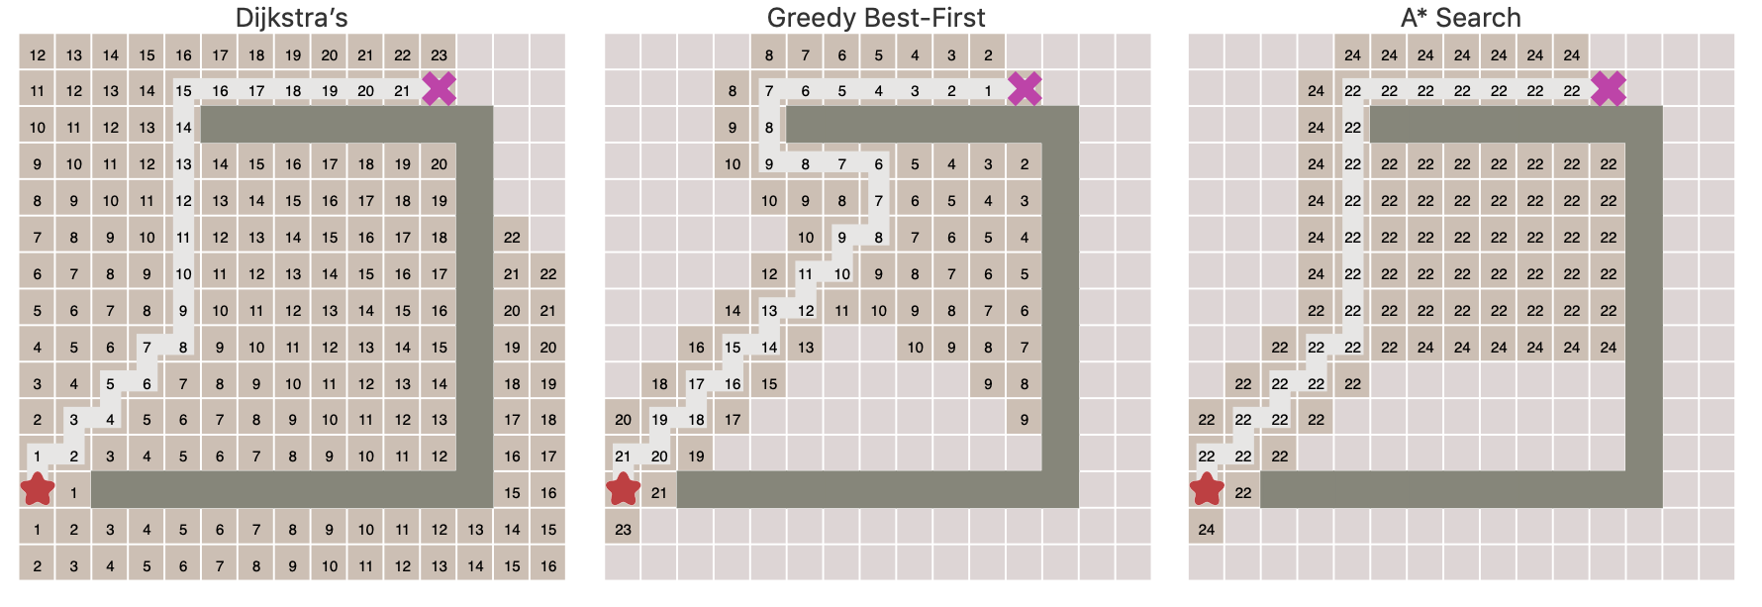
A* is optimal with admissible heuristic
https://www.redblobgames.com/pathfinding/a-star/introduction.html
Notes:
.

Slide 45


Idea: Admissibility
Inadmissible (pessimistic) heuristics break optimality by trapping good plans on the frontier
Admissible (optimistic) heuristics slow down bad plans but never outweigh true costs
Slide credit: Dan Klein and Pieter Abbeel
http://ai.berkeley.edu
Notes:
.

Slide 46

A* search example
Frontier queue:
Arad 366
Notes:
.

Slide 47

A* search example
Frontier queue:
Sibiu 393
Timisoara 447
Zerind 449
We add the three nodes we found to the Frontier queue.
We sort them according to the g()+h() calculation.
Notes:
.

Slide 48

A* search example
Frontier queue:
Rimricu Vicea 413
Fagaras 415
Timisoara 447
Zerind 449
Arad 646
Oradea 671
When we expand Sibiu, we run into Arad again. Note that we’ve already expanded this node once; but we still add it to the Frontier queue again.
Notes:
.

Slide 49

A* search example
Frontier queue:
Fagaras 415
Pitesti 417
Timisoara 447
Zerind 449
Craiova 526
Sibiu 553
Arad 646
Oradea 671
We expand Rimricu Vicea.
Notes:
.

Slide 50

A* search example
Frontier queue:
Pitesti 417
Timisoara 447
Zerind 449
Bucharest 450
Craiova 526
Sibiu 553
Sibiu 591
Arad 646
Oradea 671
When we expand Fagaras, we find Bucharest, but we’re not done. The algorithm doesn’t end until we “expand” the goal node – it has to be at the top of the Frontier queue.
Notes:
.

Slide 51

A* search example
Frontier queue:
Bucharest 418
Timisoara 447
Zerind 449
Bucharest 450
Craiova 526
Sibiu 553
Sibiu 591
Rimricu Vicea 607
Craiova 615
Arad 646
Oradea 671
Note that we just found a better value for Bucharest!
Now we expand this better value for Bucharest since it’s at the top of the queue.
We’re done and we know the value found is optimal!
Notes:
.

Slide 52
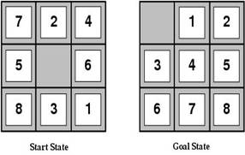
Heuristic functions
For the 8-puzzle
Avg. solution cost is about 22 steps
(branching factor ≤ 3)
(branching factor ≤ 3)
A good heuristic function can reduce the search process
Notes:
.

Slide 53
Example Admissible heuristics
For the 8-puzzle:
h_{oop}(n) = number of out of place tiles
h_{md}(n) = total Manhattan distance (i.e., # of moves from desired location of each tile)
h_{oop}(S) = 8
h_{md}(S) = 3+1+2+2+2+3+3+2 = 18
Notes:
.

Slide 54
Relaxed problems
A problem with fewer restrictions on the actions than the original is called a relaxed problem
The cost of an optimal solution to a relaxed problem is an admissible heuristic for the original problem
If the rules of the 8-puzzle are relaxed so that a tile can move anywhere, then h_{oop}(n) gives the shortest solution
If the rules are relaxed so that a tile can move to any adjacent square, then h_{md}(n) gives the shortest solution
Notes:
.

Slide 55
Defining Heuristics: h(n)
Cost of an exact solution to a relaxed problem (fewer restrictions on operator)
Constraints on Full Problem:
A tile can move from square A to square B if A is adjacent to B and B is blank.
Constraints on relaxed problems:
A tile can move from square A to square B if A is adjacent to B. (h_{md})
A tile can move from square A to square B if B is blank.
A tile can move from square A to square B. (h_{oop})
Notes:
.

Slide 56
Dominance: A metric on better heuristics
If h₂(n) ≥ h₁(n) for all n (both admissible)
then h₂ dominates h₁
So h₂ is optimistic, but more accurate than h₁
h₂ is therefore better for search
Notice: h_{md} dominates h_{oop}
Typical search costs (average number of nodes expanded):
d=12 Iterative Deepening Search = 3,644,035 nodes A*(h_{oop}) = 227 nodes, A*(h_{md}) = 73 nodes
d=24 IDS = too many nodes A*(h_{oop}) = 39,135 nodes, A*(h_{md}) = 1,641 nodes
Notes:
.

Slide 57
The best and worst admissible heuristics
h*(n) - the (unachievable) Oracle heuristic
h*(n) = the true distance from the n to goal
h_{we’re here already}(n)= h_{teleportation}(n)=0
Admissible: both yes!!!
h*(n) dominates all other heuristics
h_{teleportation}(n) is dominated by all heuristics
Notes:
.

Slide 58
Reminders
HW2 is due tonight before 11:59pm Eastern time.
HW3 has been released.
Register to vote: https://vote.gov Online registration and mail-in request deadline: Monday, October 19, 2020
Be a poll worker: https://www.votespa.com/Resources/Pages/Be-a-Poll-Worker.aspx

Slide 59
A* search is Optimal
AIMA 3.5
Notes:
.

Slide 60


Key: Admissibility
Inadmissible (pessimistic) heuristics break optimality by pushing good plans too far back on the frontier, which means they may never get expanded.
Admissible (optimistic) heuristics slow down bad plans but never outweigh true costs. That means that the true best plan will always be expanded.
Slide credit: Dan Klein and Pieter Abbeel
http://ai.berkeley.edu
Notes:
.

Slide 61



Admissible Heuristics
A heuristic h is admissible (optimistic) if:
where is the true cost to a nearest goal
Is Manhattan Distance admissible?
Coming up with admissible heuristics is most of what’s involved in using A* in practice.
Notes:
.

Slide 62


Optimality of A* Tree Search
Assume:
A is an optimal goal node
B is a suboptimal goal node
h is admissible
Claim:
A will exit the frontier before B
…
Slide credit: Dan Klein and Pieter Abbeel
http://ai.berkeley.edu
Notes:
.

Slide 63



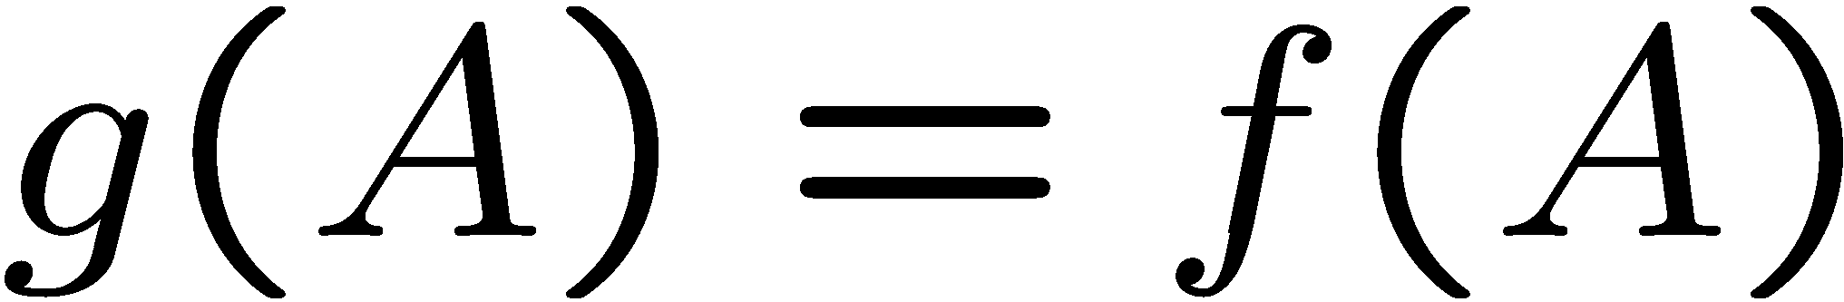
Optimality of A* Tree Search
…
Proof:
Imagine B is on the frontier
Some ancestor n of A is on the frontier, too (maybe A!)
Claim: n will be expanded before B
f(n) is less or equal to f(A)
Definition of f-cost
Admissibility of h
h = 0 at a goal
Slide credit: Dan Klein and Pieter Abbeel
http://ai.berkeley.edu
Notes:
g = path cost, h = admissible heuristic of remaining distance to goal

Slide 64


Optimality of A* Tree Search
…
Proof:
Imagine B is on the frontier
Some ancestor n of A is on the frontier, too (maybe A!)
Claim: n will be expanded before B
f(n) is less or equal to f(A)
f(A) is less than f(B)
B is suboptimal
h = 0 at a goal
Slide credit: Dan Klein and Pieter Abbeel
http://ai.berkeley.edu
Notes:
g = path cost, h = admissible heuristic of remaining distance to goal

Slide 65

Optimality of A* Tree Search
Proof:
Imagine B is on the frontier
Some ancestor n of A is on the frontier, too (maybe A!)
Claim: n will be expanded before B
f(n) is less or equal to f(A)
f(A) is less than f(B)
n expands before B
All ancestors of A expand before B
A expands before B
A* search is optimal
…
Slide credit: Dan Klein and Pieter Abbeel
http://ai.berkeley.edu

Slide 66
Properties of A*
Slide credit: Dan Klein and Pieter Abbeel
http://ai.berkeley.edu
Notes:
.

Slide 67
Properties of A*
Uniform-Cost
A*
b
b
…
…
Slide credit: Dan Klein and Pieter Abbeel
http://ai.berkeley.edu
Notes:
.

Slide 68
UCS vs A* Contours
Uniform-cost expands equally in all “directions”
A* expands mainly toward the goal, but does hedge its bets to ensure optimality
Start
Goal
Start
Goal
Slide credit: Dan Klein and Pieter Abbeel
http://ai.berkeley.edu
Notes:
.

Slide 69

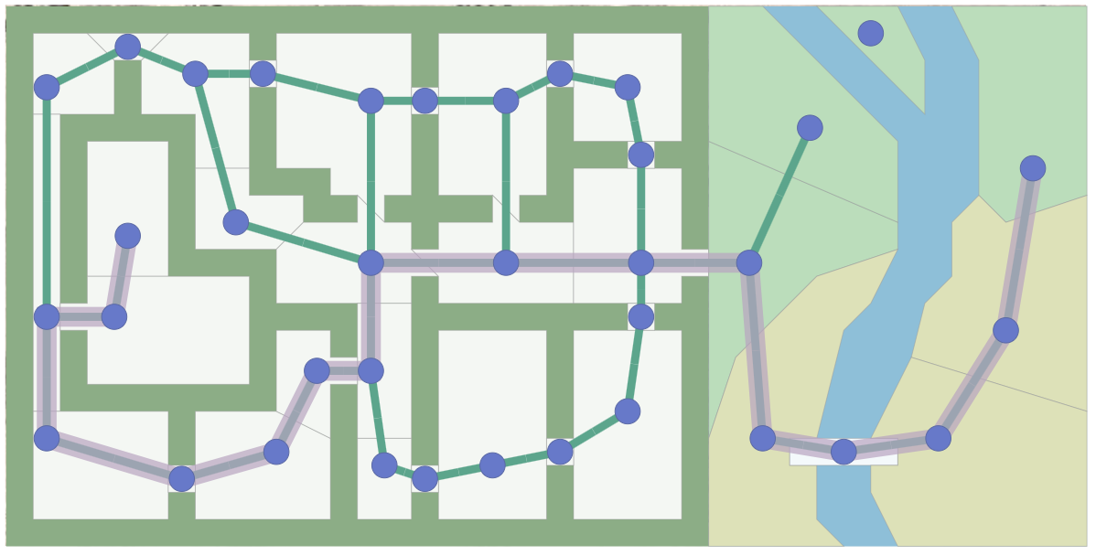
A* Applications
Pathing / routing problems (A* is in your GPS!)
Video games
Robot motion planning
Resource planning problems
…
Notes:
.

Slide 70
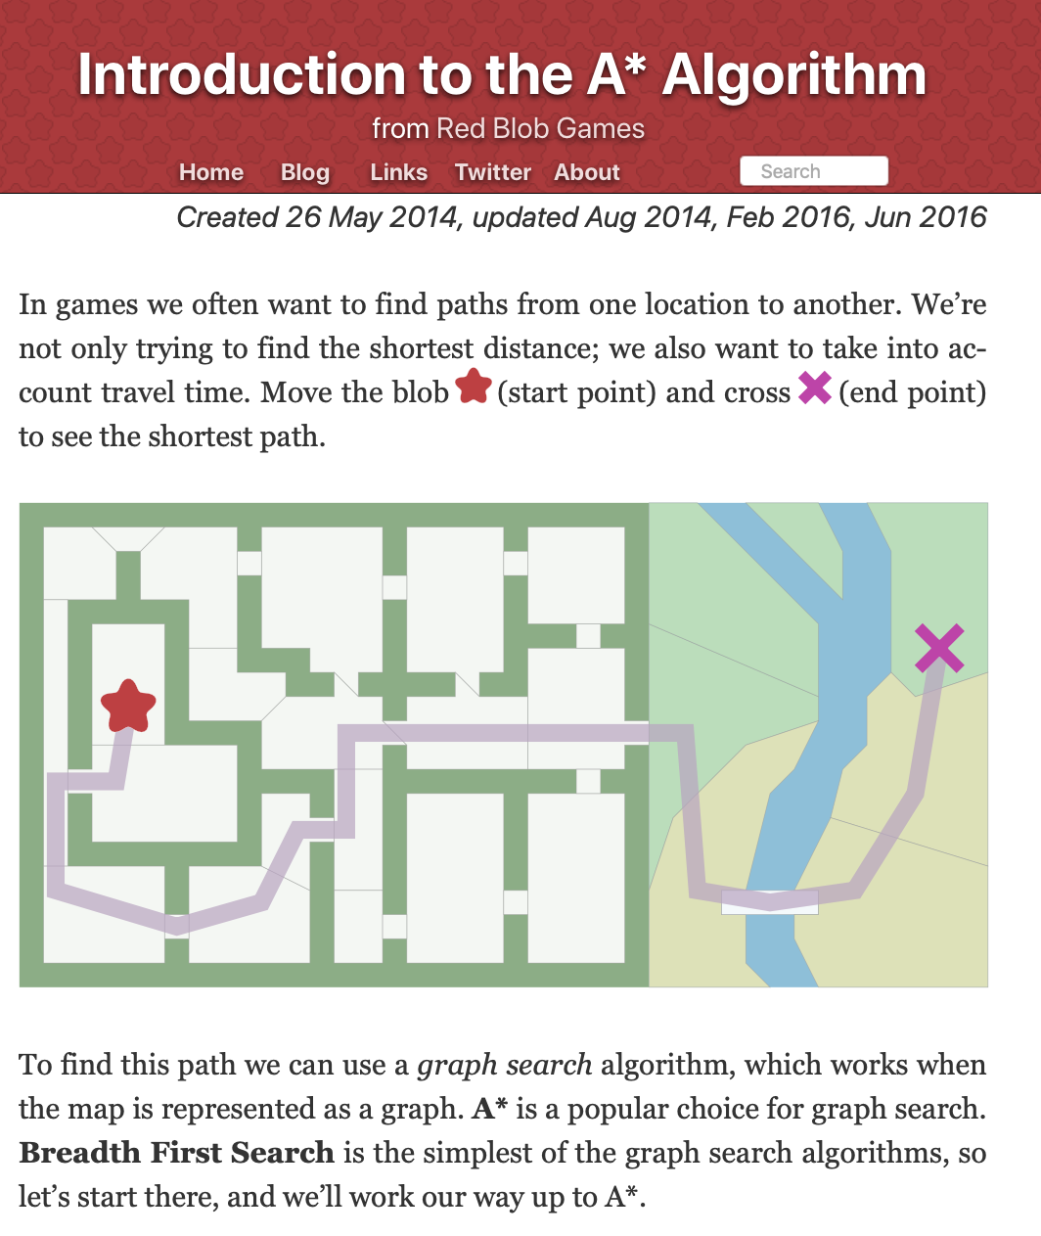
Supplemental Reading
I recommend this A* tutorial by Amit Patel of Red Blob Games
https://www.redblobgames.com/pathfinding/a-star/introduction.html

Slide 71
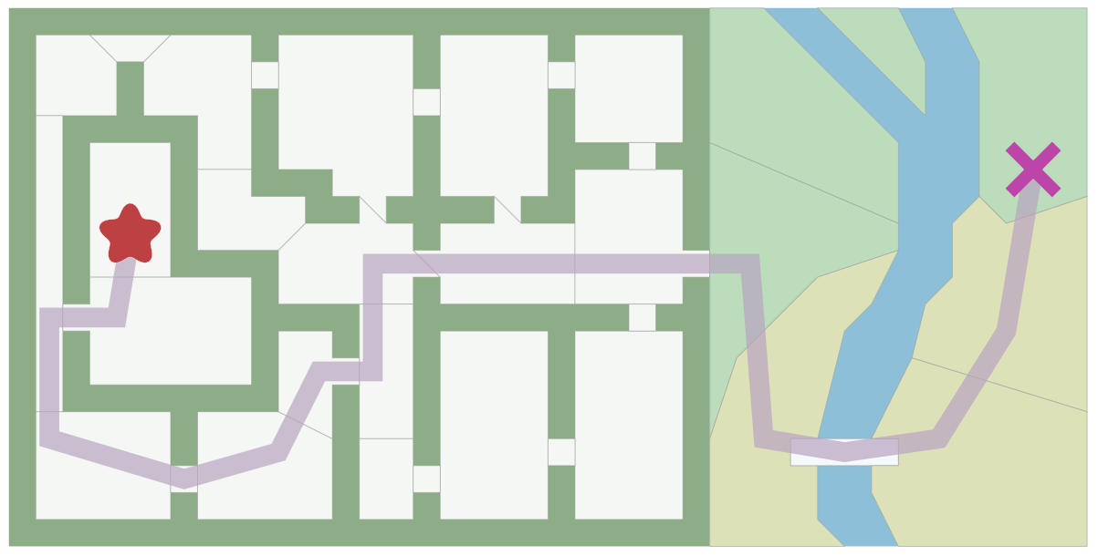
Pathfinding in Games
https://www.redblobgames.com/pathfinding/a-star/introduction.html

Slide 72
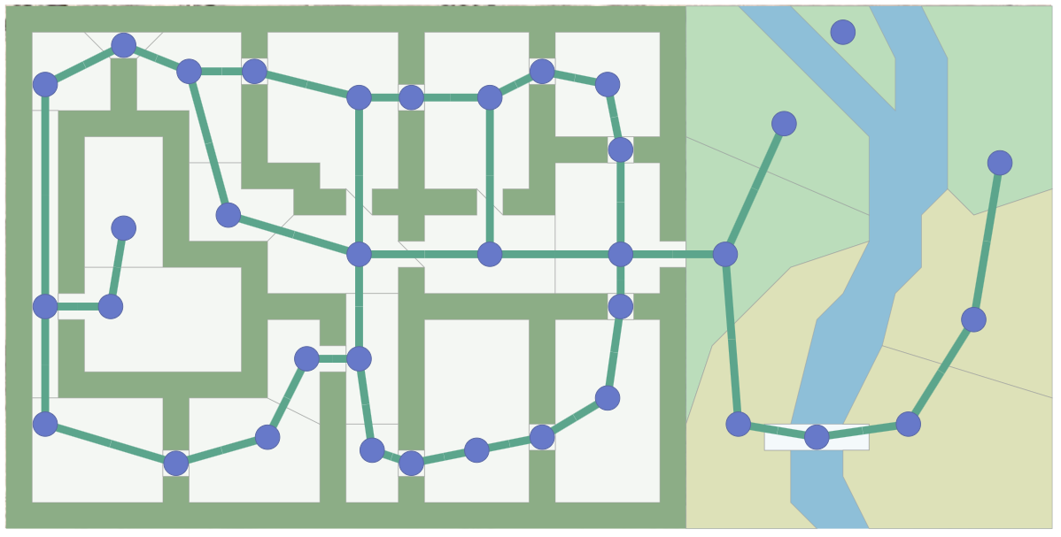
Pathfinding in Games
https://www.redblobgames.com/pathfinding/a-star/introduction.html

Slide 73
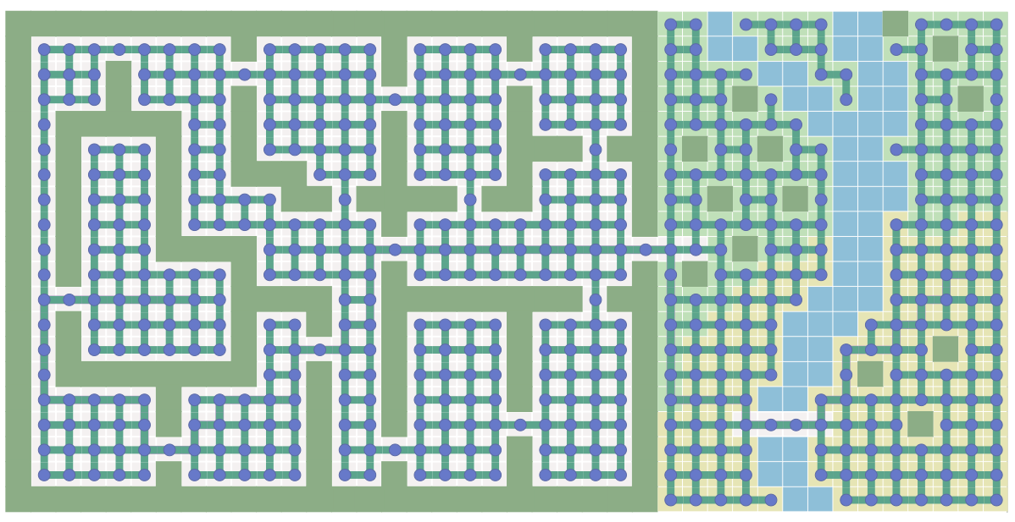
Pathfinding in Games
https://www.redblobgames.com/pathfinding/a-star/introduction.html

Slide 74
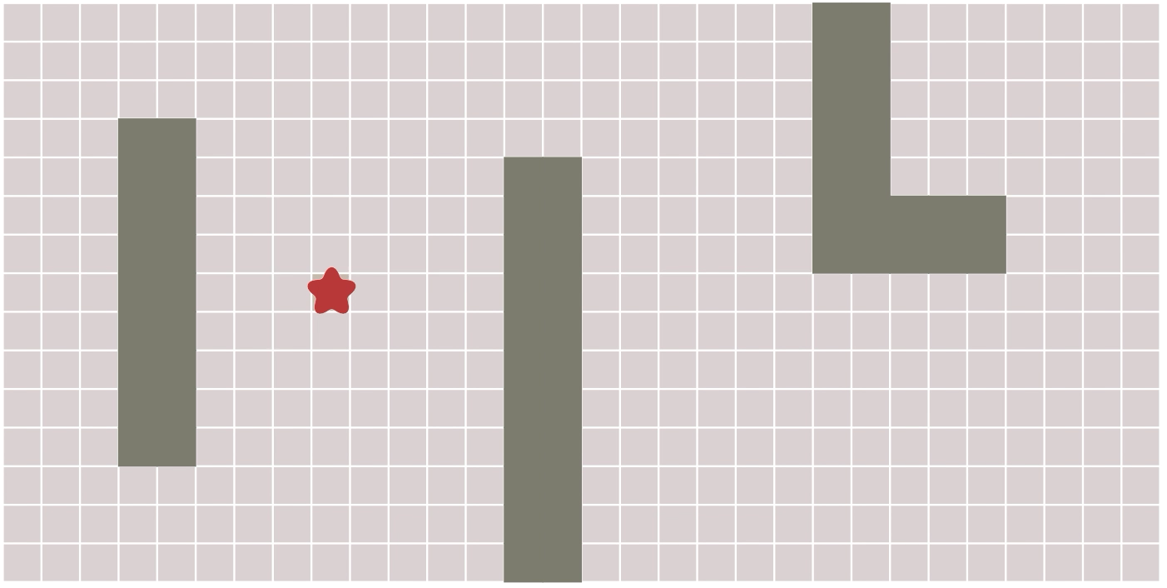
Breadth First Search
https://www.redblobgames.com/pathfinding/a-star/introduction.html

Slide 75
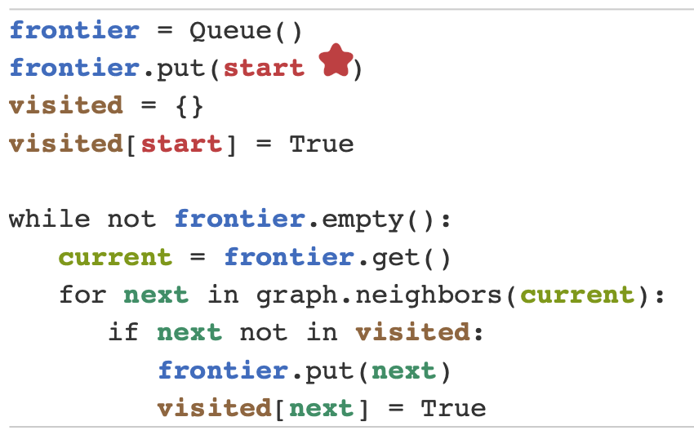
BFS in 10 lines of Python
https://www.redblobgames.com/pathfinding/a-star/introduction.html

Slide 76
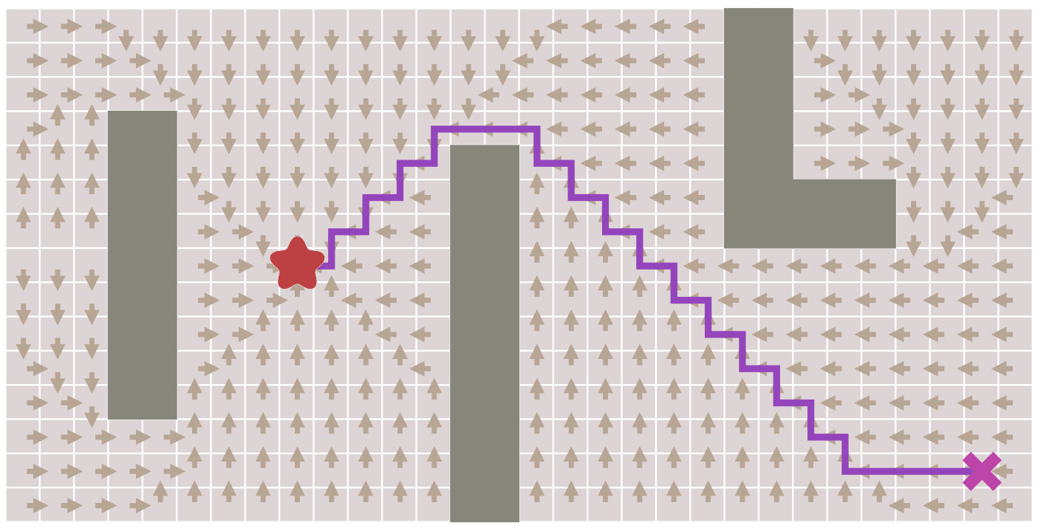
Finding the shortest path
https://www.redblobgames.com/pathfinding/a-star/introduction.html

Slide 77
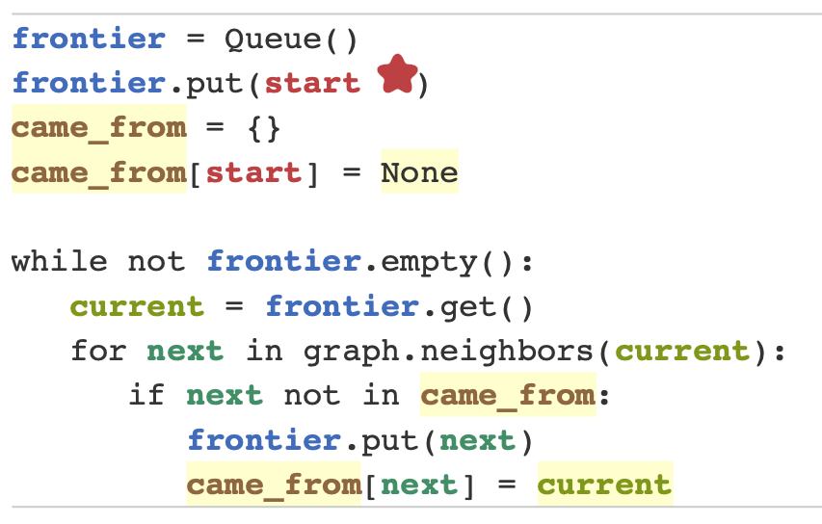
Finding the shortest path
https://www.redblobgames.com/pathfinding/a-star/introduction.html

Slide 78
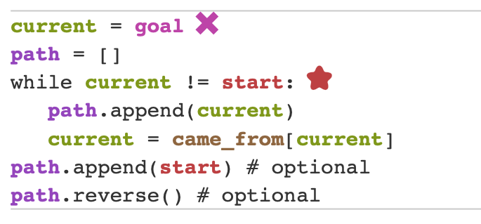
Finding the shortest path

